Slide 1
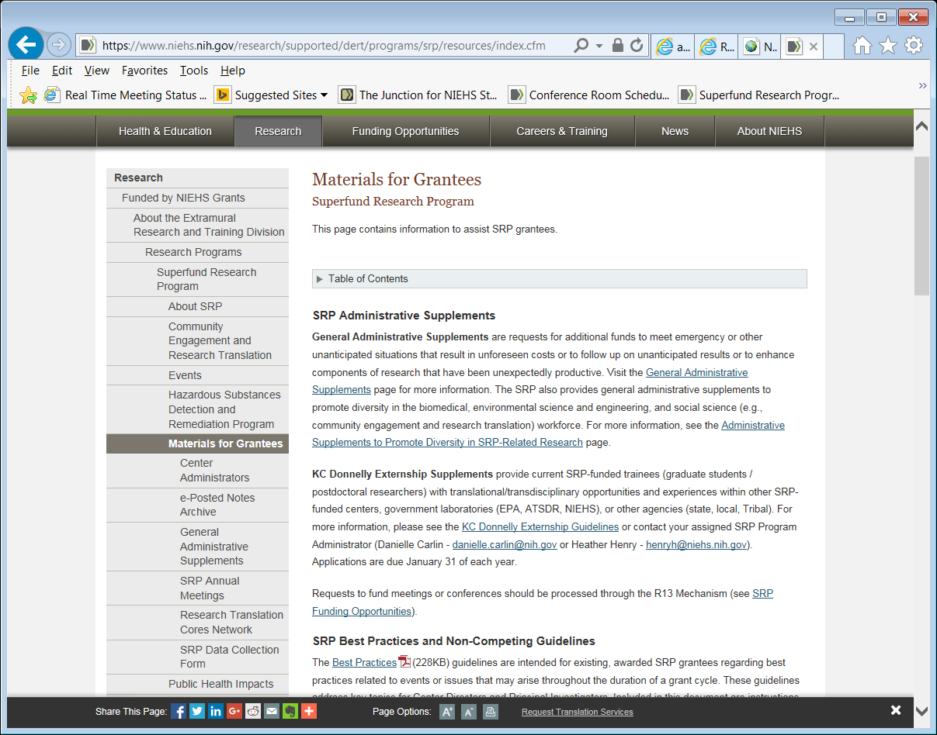
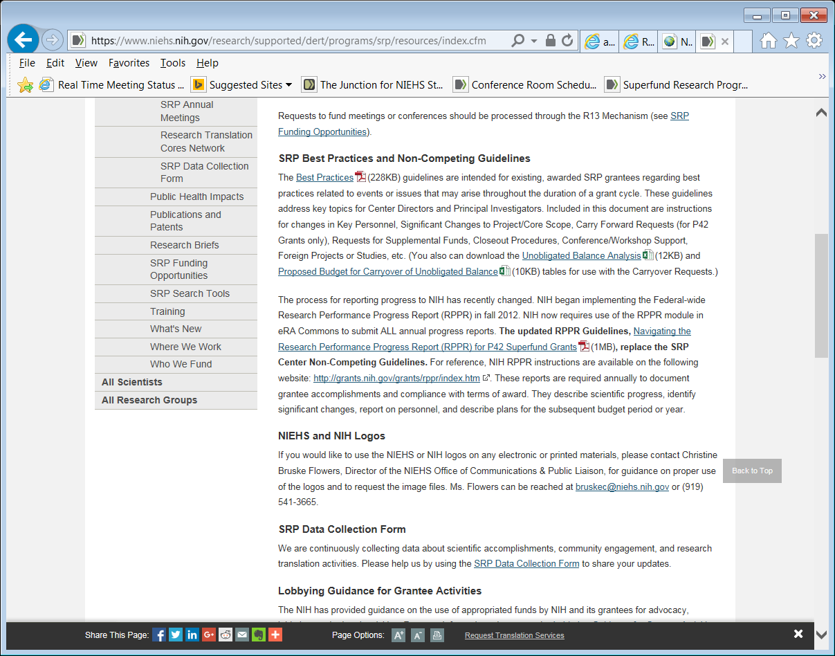
Navigating the Research Performance Progress Report (RPPR) for P42 Superfund Grants Updated: 11/10/15 (updates in green)
Available on Materials for Grantees: https://www.niehs.nih.gov/research/supported/dert/programs/srp/resources/index.cfm
Notes:
https://www.niehs.nih.gov/research/supported/dert/programs/srp/resources/index.cfm

Slide 2
Disclaimer
The instructions in these slides are not meant to supersede instructions found in the NIH Research Performance Progress Report (RPPR) Instruction Guide
http://grants.nih.gov/grants/rppr/rppr_instruction_guide.pdf

Slide 3
Outline
Instructions for entering data
Tips
Specific instructions to share with your Center Director and Project/Core Leaders

Slide 4
Getting started….
RPPRs are due February 1st of each year
Read the NIH RPPR guidelines in their entirety (version last updated on Oct. 17, 2014)
Use eRA Commons for submission of RPPR
For a multi-project/core RPPR, only the Contact PI/PD or delegate of the Contact PD/PI may initiate the report
A “component” is a distinct, reviewable part of the multi-project/core RPPR which contains detailed information such as scientific findings/highlights, performance sites, personnel, and budget (i.e., Overall Center Component and Project/Core Components)
The “components” were identified when your Center applied to the specific Request for Applications (RFA)

Slide 5
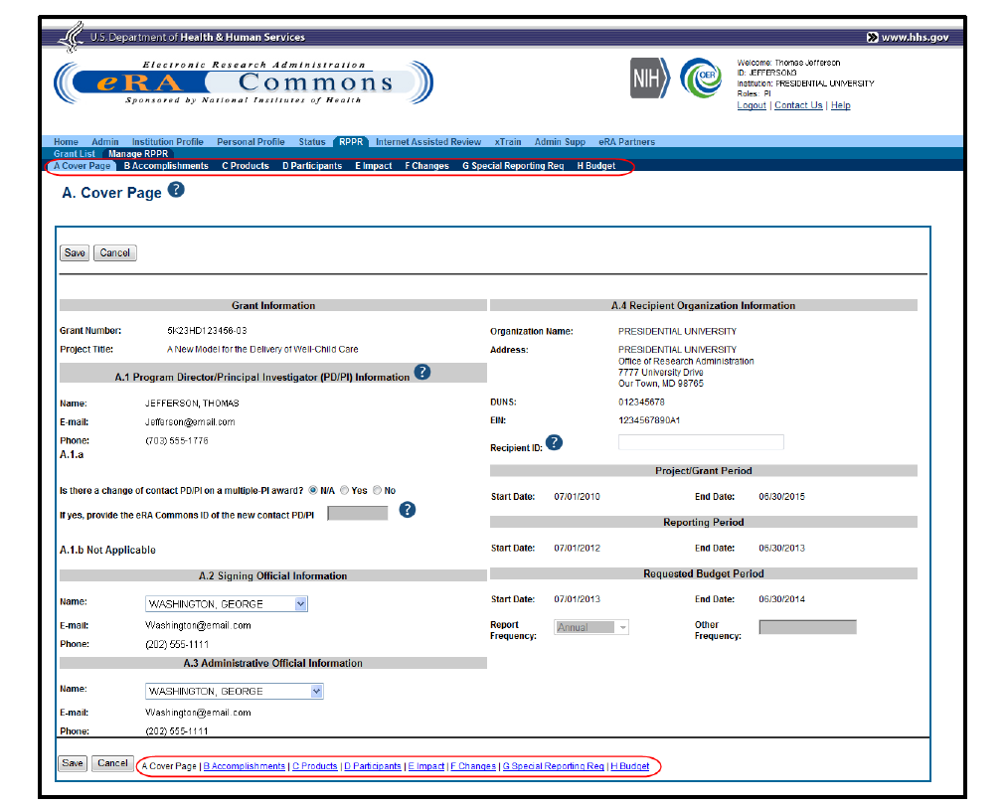
A. Cover Page
Cover Page includes information about the award, PD/PI, organization, and project/reporting/budget periods. Much of this information is pre-populated from data in eRA systems, but certain fields are editable.

Slide 6
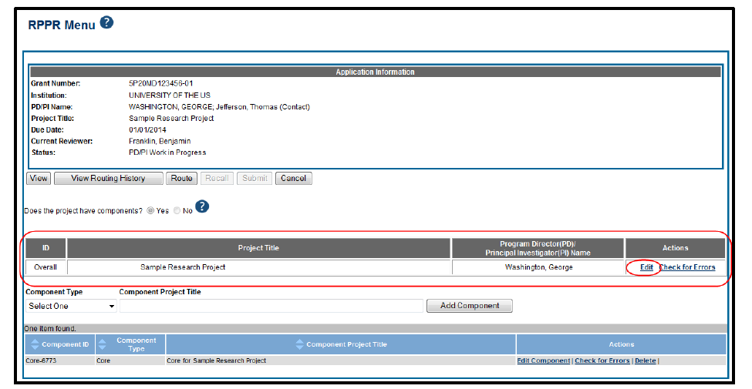
Overall Component
Click on “Yes” for “Does the project have components?”
To edit the RPPR for the Overall, select the Edit link from the Actions column
The Overall Center Component has specific instructions in the RPPR guidelines; see Section 7.6.1 of RPPR guidelines

Slide 7
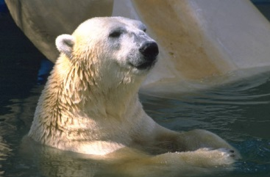
B. Accomplishments - Overall
The Overall Center component provides overview of the Center’s accomplishments in the most recent budget period.
Cool feature: In subsequent RPPRs, section B.1 will pre-populated with the aims/goals previously entered, and may be amended by answering Yes* to question B.1.a.
*Note: Grantees must obtain prior written approval from the awarding agency grants official whenever there are significant changes in the project or its direction (i.e. aims/goals).

Slide 8
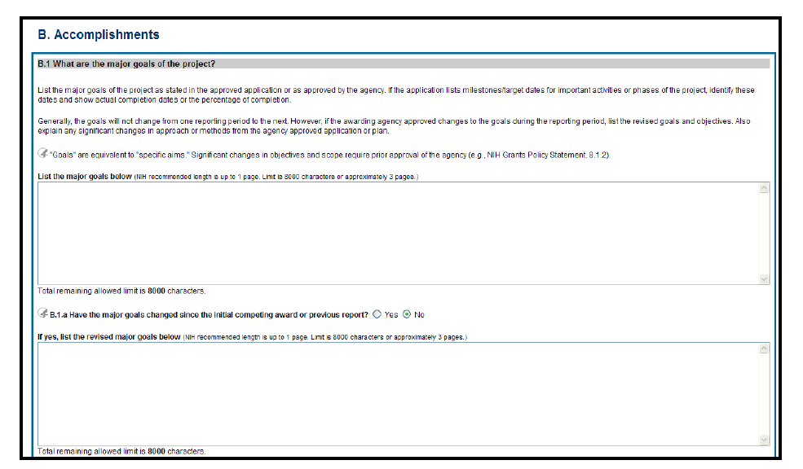
B.1. Accomplishments – Major Goals - Overall

Slide 9
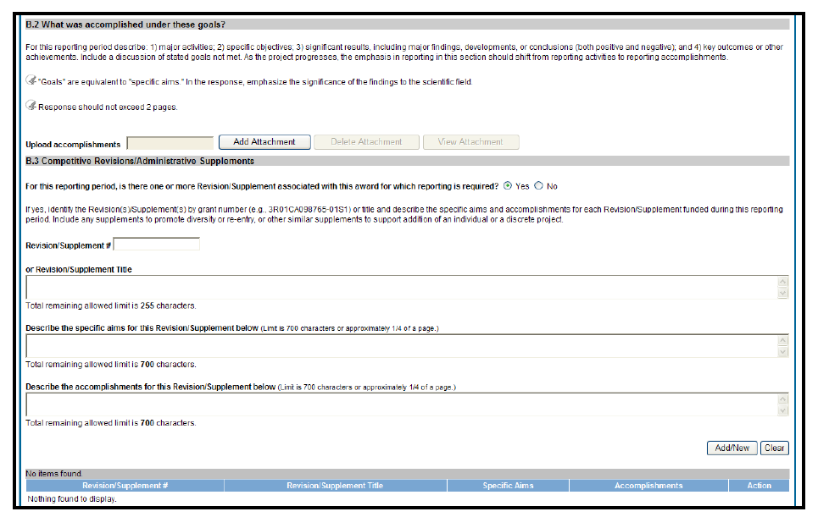
B.2. & B.3. Providing Goal & Administrative Supplement Information - Overall
These are the Overall Center Highlights that should be copy/pasted in the Annual Updates, due as a Word Doc to srpinfo@niehs.nih.gov on Feb. 15th
Administrative Supplements should be added to the Overall Center Component and not in the individual components (i.e., Projects/Cores) – includes General, KC Donnelly, Diversity, and Annual Meeting Supplements

Slide 10
B.2. Goals - Overall Component
Attach “Overall Center Highlights” here
Centers should briefly report major highlights from among the projects and cores (3 to 4 highlights)
discoveries or activities that have made a big impact (or are likely to make a big impact)
accomplishments with an impact on public health or has the potential to impact public health; major contributions to the body of scientific information (e.g., seminal publication); influence on decision-making progress at a Superfund Site or at a local, state, or federal level; reduction in uncertainty in the risk assessment process; or improvement/application of detection technologies and remediation strategies/processes, etc.
Ideally, Overall Center Highlights will include a mix of biomedical, environmental science & engineering (non‐biomedical), and core discoveries/accomplishments

Slide 11
B.2. Goals - Overall Component, cont.
State WHY a highlight is significant
If possible, include quantifiable estimates of cost savings, reduced disease incidence, key scientific discovery (e.g. uncovering new mechanism), reduction of time for cleanups, etc. relevant to the discovery or activity. If highlighted work has been published, please include the citation (e.g. Author, Year) of the publication or patent in the text
Limit each highlight to ~250 words (provide greater level of detail in the individual project or core progress narrative)
Total highlights should be limited to 2 pages for this section
Note: RPPR instructions say to include “Goals not met” but this is not appropriate for the Overall Center, but are appropriate for the project/core component sections and should be included there
Minor change from last year: we ask that you put RTC/CEC highlights to Overall Outreach to Communities Section B.5. (See Slide 15)
Note: this section (named “Overall Center Highlights”) should be included in the Annual Updates, due to srpinfo@niehs.nih.gov as a Word Doc on Feb. 15th)

Slide 12
B.3. Supplements - Overall
Report progress on all administrative supplement awards that have not been previously reported and are completed or active
This is a requirement
In order to fill this out, you will need the supplement number; Supplements generally have a 3 in front of the grant number (i.e., Type 3)
Please contact your Program Administrator if you have a question about which awards to report
Provide highlight of progress of each supplement award
Mention again purpose of supplement in write-up
Specific Aims and Accomplishments are limited to 700 characters each
If applicable to your grant, report activities for re-instatement of funds
If supplement resulted in publication(s), please cite reference in text in the accomplishments box
If you have more than one supplements, click on Add/New button at bottom right

Slide 13
B.4. Opportunities for training (and professional development) that the project provided - Overall
Include Trainee Highlights here (this is the same Trainee Highlights included in the Annual Updates due to srpinfo@niehs.nih.gov by February 15th)
This section should be included for those Centers with and without Training Cores
Note: Individual Development Plans (IDPs) are not in the Request for Applications (RFA), so you do not need to describe whether your institution has these established

Slide 14
B.4. Opportunities for training (and professional development) that the project provided - Overall
Trainee Highlights: Briefly highlight significant accomplishments by your trainees over the past funding year
Include most significant awards, publication accomplishments (include “Author, Year” citation), fellowship awards, notable career advances, etc.
SRP trainees are defined as graduate students and post-doctoral researchers either directly supported by the P42 grant or conducting research/activities supported by the grant
Centers with Training Cores should provide more details of Training Core-specific activities in the Training Core Component
In addition, please include in this section any “Trainee Success Stories” – e.g. brief highlights of particularly successful trainees (current or alumni)
This attachment is limited to 3 pages
Note: a list of all publications and presentations will be included in each project/core section B.5 “Results to communities of interest;” therefore, please only include highly significant trainee publications and presentations in this section, “Overall B4 Opportunities for Training.”

Slide 15
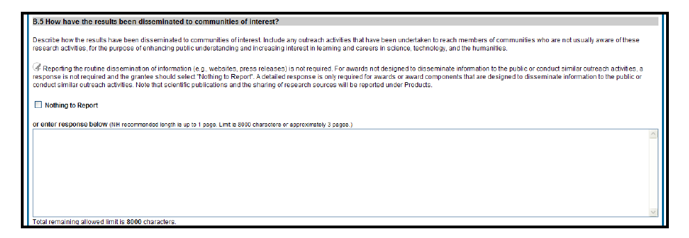
B.5. Results to communities of interest - Overall
Briefly highlight significant research translation and community engagement accomplishments over the past funding year
Choose best from Data Collection Tool
Please limit to the top 3 highlights for RTC and CEC and limit to ~250 words for each highlight
This section is just for the highlights; more detail should be provided in the RTC/CEC component sections
Remember to define which communities you are working with (e.g., stakeholders, community groups)
Note that scientific publications, sharing of research resources, and patents/licenses will be reported in the Overall Component under Products (Section C)

Slide 16
B.6. Plan for the next reporting period to accomplish goals - Overall
Note: Significant changes in objectives and scope require prior approval of the agency (e.g., NIH Grants Policy Statement, 8.1.2.)

Slide 17
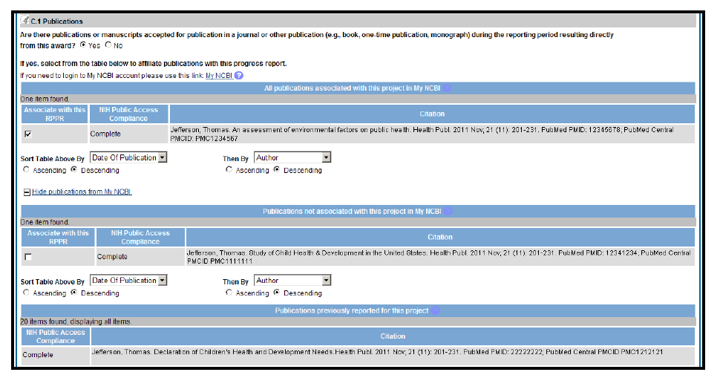
Section C – Products - Overall
C.1. See RPPR guidelines regarding Publications.
Note: the RPPR combines publications in this Overall Section, without regard to specific project/core. (Note: Please report publications on a per project/core basis in the Annual Updates – due Feb. 15th to srpinfo@niehs.nih.gov)
NOTE: It is critical that your PIs include their Grant Number in all publications. MyNCBI searches for Grant Numbers and PI last names, which can be used to develop a bibliography that captures all of the Center’s publications.

Slide 18
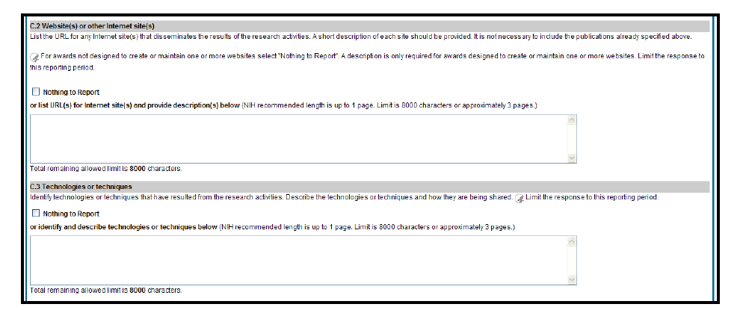
Section C – Products - Overall

Slide 19
Section C – Products - Overall
C.2. Websites
For Overall Center, list Center website
If applicable, list specific websites that pertain to each project/core component in this section
C.3. Technologies or Techniques: For Overall Center component, click on “Nothing to Report”
Fill out on a per projects/core component basis (if applicable)

Slide 20
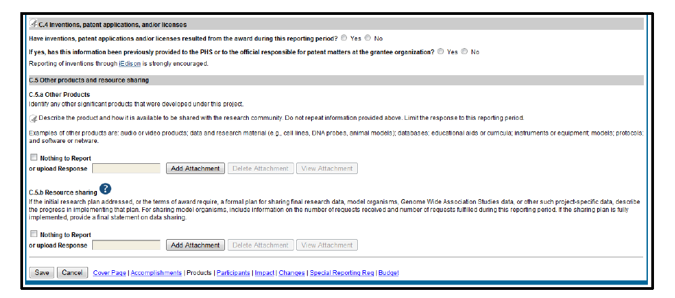
Section C – Products - Overall
C.4. Inventions/Patents: Fill out for Overall Center Component
C.5a. Other Products: in addition to what is asked in this section, please include an explanation of patents, inventions, and licenses that were reported in C.4
C.5b. Resource Sharing: For Overall Center component, click on “Nothing to Report”
Fill out on a per project/core component basis (if applicable)

Slide 21
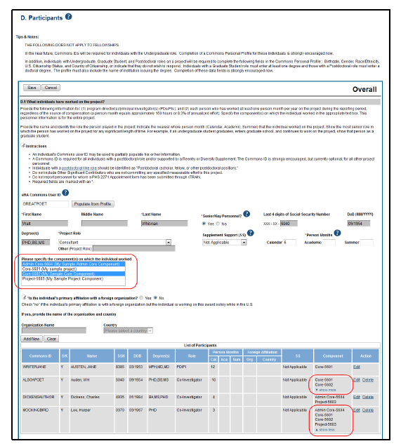
D. Participants - Overall

Slide 22
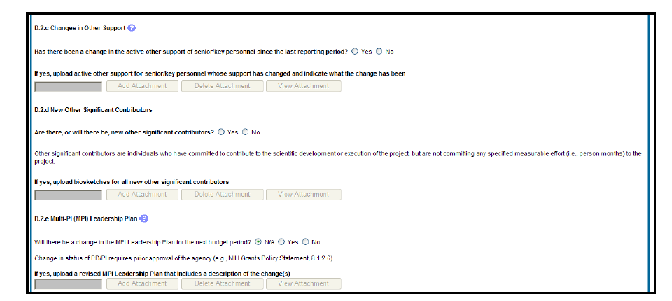
D. Participants - Overall

Slide 23
Section D. Participants - Overall
D.1. All participants should be listed under the Overall Center Component. There will be the option of selecting which Projects/Cores for which each of the participants are involved in.
NIH now requires an eCommons ID for all trainees (i.e., undergraduates, graduate students, and Post-Docs) who spend more than 1 calendar month/year performing research/activities on the grant. Please be sure all eligible trainees register with eCommons and include them in your “D. Participants” section. (Note – eCommons ID is also required for any new trainees to be added to CareerTrac.)
D.2.a & D.2.b Level of Effort. The RPPR process can be used to submit materials for a prior approval request for notification of a 25% changes in level of effort of Key Personnel (e.g. change in Key Personnel). If you plan to use this function:
Please contact your SRP Program Administrator and Grants Management Specialist before submission of the RPPR (preferably in early January 2016).
Listing changes in level of effort does not necessarily indicate prior approval.
New senior key personnel: for addition of new senior/key personnel, a prior approval request is required
Provide additional information about changes to Key Personnel in the Administrative Core component section B.2.

Slide 24
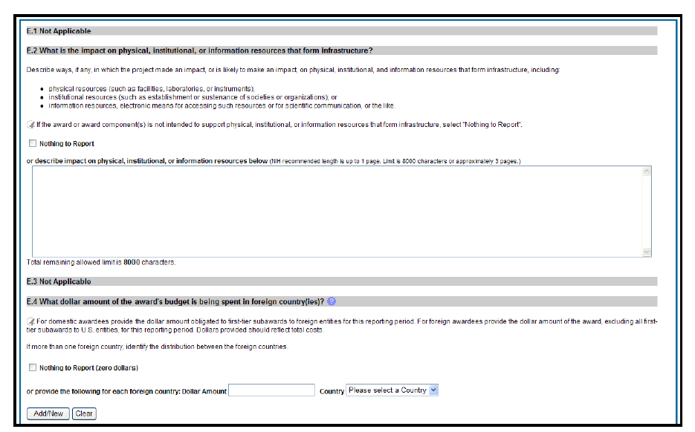
Section E. Impact

Slide 25
Sections E - Overall
Section E. Impact*
E.1. No title. Not Applicable
E.2 What is the impact on physical, institutional, or information resources that form infrastructure? For P42 grants, this may not apply.
E.3 No title. Not Applicable
E.4 What dollar amount of the award’s budget is being spent in foreign country(ies)?
*See RPPR guidelines for more information

Slide 26
Section F - Overall

Slide 27
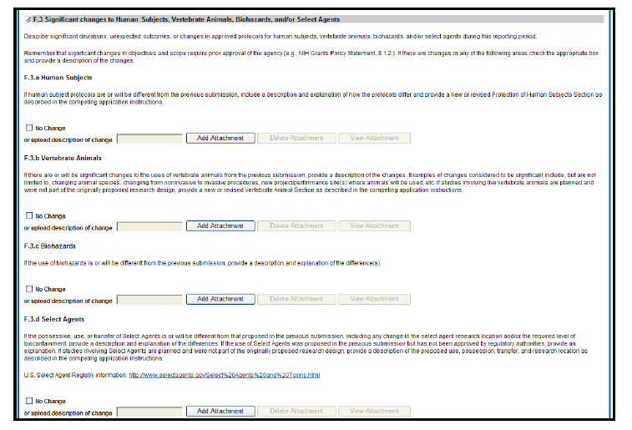
Section F - Overall

Slide 28
Section F - Overall
Section F. Changes*
Note: Studies involving human subjects are being closely followed by NIH/NIEHS. Please be sure that all enrollment tables are updated and to be clear and transparent about changes/challenges to enrollment. [Comments from Administrators? How is this working?]
F.1. No Title and is Not Applicable.
F.2 Actual or anticipated challenges or delays and actions or plans to resolve them. (In box, please refer to affected projects/cores, and describe in detail changes in respective project/core component)
For F.3, if there are changes to Human Subjects, Vertebrate Animals, Biohazards, and/or Select Agents, check the appropriate box and for Overall Component, provide a pdf document indicating which projects/cores are affected (as applicable). More importantly, report a description and explanation of specific changes under the relevant project/core component.

Slide 29
Section G - Overall
Note: No screen shot available for G.4.a

Slide 30
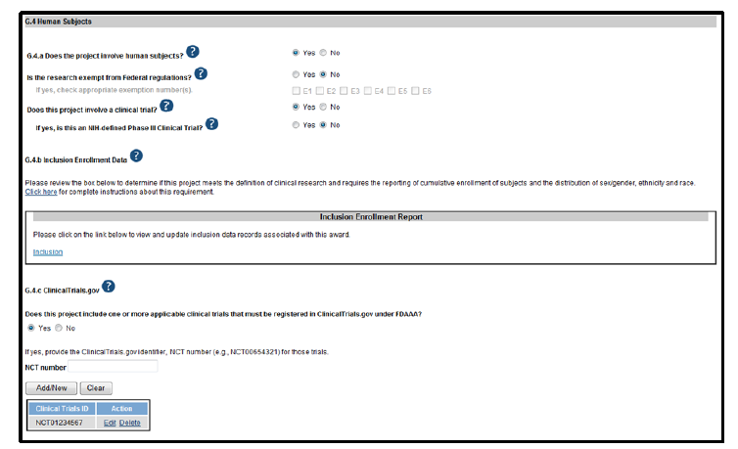
Section G - Overall

Slide 31
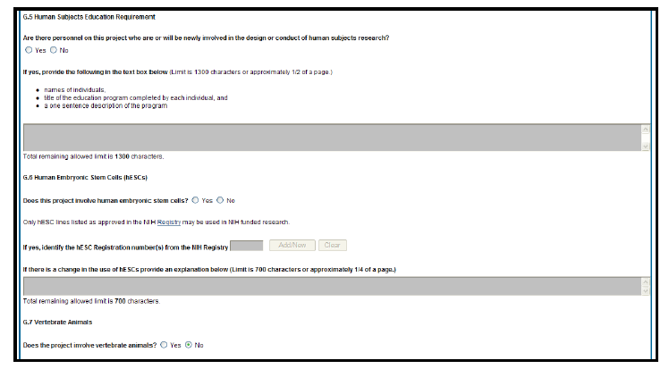
Section G - Overall

Slide 32
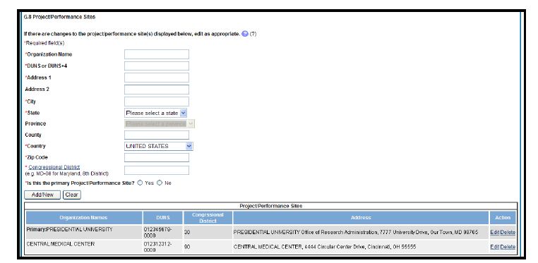
Section G - Overall

Slide 33
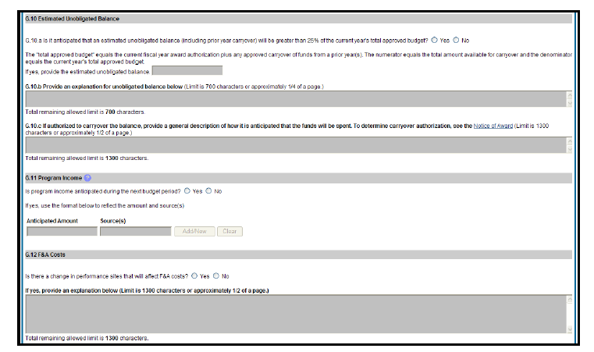
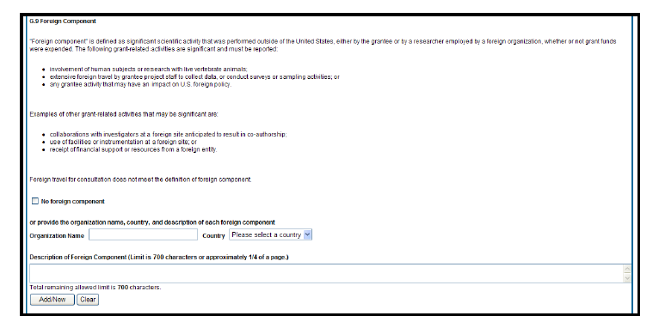
Section G - Overall

Slide 34
Sections G & H - Overall
Section G. Special Reporting Requirements
G.1., Special Notice of Award and Funding Opportunity Announcement Reporting Requirements – Click on Nothing to Report; The NOA states that participants at annual meeting should be provided in the RPPR, but we are requesting that they be reported in the Administrative Core Component
G.2. No title (Not Applicable)
G.3. No title (Not Applicable)
G.4. Human Subjects
G.4.a Does the project involve human subjects?
G.4.b Inclusion enrollment data
G.4.c ClinicalTrials.gov (Fill out if applicable)
G.5 Human Subjects Education Requirement*
G.6 Human Embryonic Stem Cell(s)*
G.7 Vertebrate Animals*
G.8 Project Performance Sites*
G.9 Foreign component*
G.10 Estimated unobligated balance*
G.11 Program Income (if applicable)*
G.12 F&A Costs (Not Applicable because we are non-SNAP)
Section H. Budget
See RPPR guidelines for more information
For questions pertaining to the budget and budget format, please contact your SRP Grants Management Specialist listed on your Notice of Award (NOA)
*Note: see RPPR for additional information

Slide 35
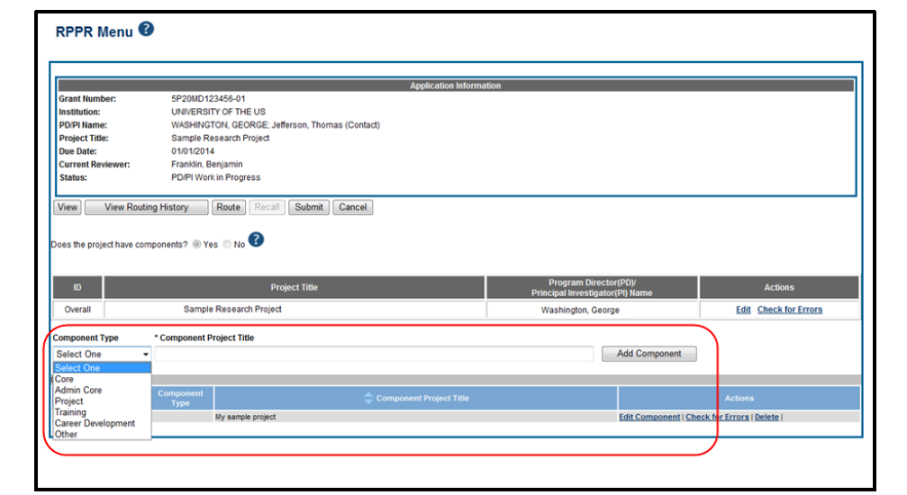
Adding Components
1. Select the correct option from the Component Type drop- down list.
2. Enter the Component Project Title (please use the title listed in the parent application)
3. Select the Add Component button (Project = Biomedical/Environmental Science and Engineering; Admin Core = Administrative Core; Core = RTC, CEC, TC, and Research Support Cores)

Slide 36
For ALL Components
The Instructions for RPPR Sections A–H in Chapter 6 are applicable to each individual component with exceptions listed in in section 7.6.2 (Component Instructions)
See section 7.6.2 for filling our Section A.
B.1. Aims/Goals: State specific aims and describe any modifications to the Specific Aims since the last competing application.
B.1.a Have the major aims/goals changed since the initial competing award or previous report? Click on Yes or No
B.2. Studies and Results:
Progress Update for SRP Website: in the first paragraph, summarize major accomplishments of over the last funding cycle. Please note that these will be used for the SRP website, so do not include proprietary information. (You will need to compile this paragraph for each project/core as part of the Annual Updates submitted to srpinfo@niehs.nih.gov due Feb. 15th). Limit to 250 words and include citations (e.g., Author, Year) as applicable.
Full Project/Core Progress Report: For subsequent paragraphs, describe studies directed toward each specific aim with positive and negative results obtained. If technical problems were encountered, describe how approach was modified. This section may include unpublished data and will not be used for the SRP website.
For all accomplishments: include translational significance: money/time saved in clean‐ups, quantifiable reduction in diseases, potential clinical intervention or diagnostic tool (e.g. biomarker), vastly improved detection limit, etc. Cite publications or patents within the text.
Note new policy on Rigor, Transparency, and Reproducibility.
For additional information about project/core components, please see slides 45-50.

Slide 37
For ALL Components
B.3 Competitive Revisions/Administrative Supplements (Not applicable)
Note: these are reported in the Overall Component section
B.4 What opportunities for training and professional development has the project provided?
B.5 “Results to communities of interest” section should include a list of publications on a per project/core basis (in prep, submitted, in press, and published), oral/poster presentations, book chapters, etc.
Note – to help you get started on this section, please refer to the Annual Update webpage where we have provided you with a list of SRP’s records of your Center’s publications on a per-project, per-core basis. [Comments from Administrators: was this helpful?]
B.6 Plans: Summarize plans for next year; include plans for investigator-initiated research translation (e.g. plans that may involve moving a technology to a field site). Note new policy on Rigor, Transparency, and Reproducibility.
Notes:
Heather: note that MDB said that publication list provided as an excel sheet appears to not have been very helpful.

Slide 38
Rigor, Transparency, & Reproducibility
New NIH policy
More information: http://grants.nih.gov/reproducibility/index.htm
Notes:
Heather: Let them know that NIH has a new policy on rigor, transparency, and reproducibility. I would suggest that you tell them to read the policy (go to link) and make sure that they include a description of scientific premise, scientific rigor, biological variables, such as sex, age, weight, and underlying health conditions, and authentication of key biological and/or chemical resources. You can also let them know that we will be discussing this more during the P42 RFA discussion.

Slide 39
For ALL Components
C.1. Publications (Not Applicable)
C.2. Website(s) or other internet site(s) (Not Applicable)
C.3 Technologies or techniques (e.g., new technologies/techniques from a research project or activities from Research Support Cores).
C.4. Inventions, patent applications and/or licenses (Not Applicable)
C.5a&b. Project-Generated Resources: Please report on sharing of data and resources (e.g., GWAS data and Model Organisms). If these have been produced and are not being shared, state why not
Refer to the project/core “Data-Sharing Plan” (from original P42 Application) for additional activities to report and or resources that have been generated.
Report investigator-initiated research translation in C.5.b
All of Section D – Participants (Not Applicable)
E.1 Not title (Not Applicable)
E.2 What is the impact on physical, institutional, or information resources that form infrastructure? (Not Applicable)
E.3. What is the impact on Technology Transfer?
E.4. What dollar amount of the award’s budget is being spent in foreign country(ies)? (Not Applicable)
C.1., C.2., and C.4. will be asked for a per project/core basis in Annual Updates due to srpinfo@niehs.nih.gov by Feb. 15th

Slide 40
For ALL Components
F.1. No title (Not Applicable to most awards.)
F.2. Actual or anticipated challenges or delays and actions or plans to resolve them.
Please include any anticipated unobligated balances here and explanation for unobligated balance
F.3. Significant changes to human subjects, vertebrate animals, biohazards, and/or select agents.
G.1. Special Notice of Award and Funding Opportunity Announcement Reporting Requirements (Not Applicable)
G.2. No title. (Not Applicable)
G.3. No title. (Not Applicable)
G.4. Human Subjects
G.4.a Does the project involve human subjects?
G.4.b Inclusion enrollment data
G.4.c ClinicalTrials.gov (Not Applicable)
G.5 Human Subjects Education Requirement (Not Applicable)
G.6 Human Embryonic Stem Cell(s)
G.7 Vertebrate Animals (Not Applicable)
G.8 Project/Performance Sites (Not Applicable)
G.9 Foreign component (Not Applicable)
G.10 Estimated unobligated balance (Not Applicable)
G.11 Program Income (Not Applicable)
G.12 F&A Costs (Not Applicable)
H. Budget
H.1 Budget Form
H.2 Subaward Budget Form

Slide 41
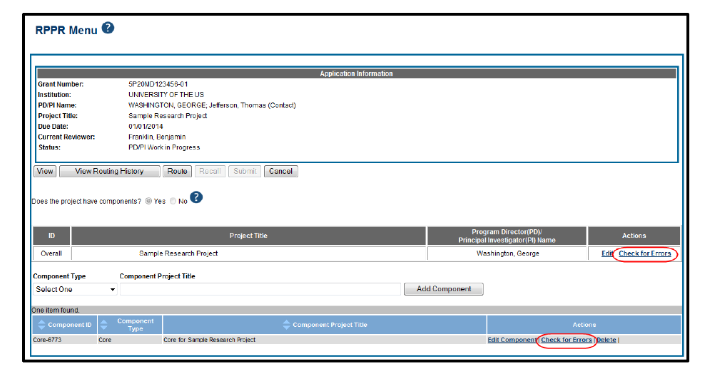
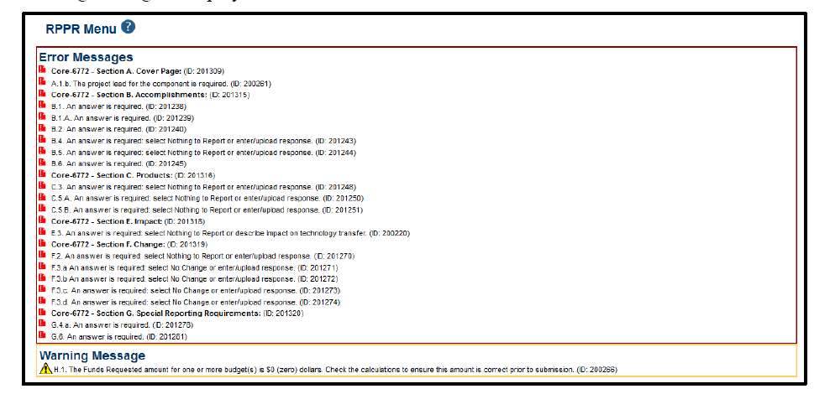
Tips - Checking for Errors

Slide 42
Tips
Please work with your Project/Core Leaders about character and page limitations
Most text entry boxes have an 8,000 character limit (~3 pages); entry of more than 8,000 characters is prevented by the system.
PDF file uploads (attachments) do not have page limits, but may not be more than 6 megabytes (6MB).
Navigating away from any page on the RPPR without selecting Save results in the loss of any information entered prior to the last save
If you choose to delete a component, all data related to this component including all budget data will be lost; this data cannot be recovered once it has been deleted.
For multi-component RPPRs, the grantee must enter the DUNS and Organization Name fields, as the DUNS number will not be automatically populated
All errors must be corrected prior to submission; the system will prevent submission of an RPPR containing errors. However, the system will not prevent submission of an RPPR when a warning message is displayed.
The warning messages should be reviewed to determine if an issue should be addressed.
If all validations pass, a message displays indicating: No errors found on validation.

Slide 43
Tips Cont.
A PD/PI delegate cannot route an RPPR to the next reviewer or recall an RPPR.
The RPPR does not replace prior approval requests. All prior approval requests must be submitted directly to the Grants Management Officer of the awarding component in accord with the Grants Policy Statement, 8.1.2.
The Center Director is strongly encouraged to view the RPPR prior to submission to ensure that the correct information and attachments are provided.
PLEASE use language Scientific American or equivalent. Remember RPPRs are often used by SRP staff for Congressional Justification, at meetings/workshops, and when reporting your findings to the public.
Utilize the CDC Tool: Clear Communication Index www.cdc.gov/ccindex
Notes:
Please note: All progress narratives (whether for the Center, Project, Core, etc.) should be written in non-technical/plain language (please see the NIH website on plain language: http://grants.nih.gov/grants/plain_language.htm). The advances should be detailed enough for use by NIEHS staff for reporting to NIH leadership, Congress, and the public. In general, each Project and Core Progress Report should contain language understandable to a scientist who may not be a specialist in the project's research field. The style used in Scientific American articles would be appropriate. Abbreviations and language that may not be known to the broader scientific community should be avoided unless clearly defined.

Slide 44
Resources
NIH RPPR Instruction Guide: http://grants.nih.gov/grants/rppr/rppr_instruction_guide.pdf
Helpful webinars and YouTube videos posted
http://grants.nih.gov/grants/rppr/
System issues or comments
eRA Help Desk: http://grants.nih.gov/support
1-866-504-9552
Content questions or comments
E-mail GrantsPolicy@od.nih.gov
SRP Annual Updates
https://tools.niehs.nih.gov/srp/resources/updates.cfm
NIH Plain Language
http://grants.nih.gov/grants/plain_language.htm
CDC Clear Communication Index
www.cdc.gov/ccindex
Per Naomi Hirsch (OSU), this presentation about “Managing Compliance Using My NCBI” may be helpful to others: http://superfund.oregonstate.edu/internal

Slide 45
Slides to share with your Center Director and Project/Core Leaders

Slide 46
For Project Components (Biomedical and Environmental Science and Engineering)
B.1.: include succinct “elevator pitch” in plain English describing the overall goal of the project (2-3 sentences) in plain language. This should be “time-neutral” and will set the backdrop for the accomplishments (i.e., B.2) which are time-specific (based on the current budget year). In addition to the elevator pitch, please describe specific aims and the percentage of completion of each specific aim.
B.2.: include the following information:
Progress Summary for SRP Website: in the first paragraph, summarize major accomplishments of over last funding cycle. Please note that these may be used for the SRP website, so do not include proprietary information. Limit to 250 words and add citations (e.g.. Author, Year) as applicable
Full Progress Report: following your “Progress Summary for SRP Website,” in the subsequent paragraphs please describe studies directed toward each specific aim with positive and negative results obtained. This section may include unpublished data and will not be used for the SRP website.
Please do not forget to include the following for all accomplishments:
What model (e.g., cell/animal/human). If study is epidemiology or involves specimens from a human population, please provide context about that population/group (location of population, exposure, disease, etc).
What media (soil, sediment, groundwater, drinking water, etc)
What assay/approach
Which contaminant and dose/concentration
What disease/endpoint; what mechanism or biological pathway
What clean-up or monitoring process does your research utilize or seek to improve?
List sites where work being tested or reference sites
Please remember to include:
Relevance of your research to environmental public health and Superfund. For example: how does your research apply to improving risk assessment, how does it apply to setting health-based standards for superfund sites, quantifiable reduction in diseases, potential clinical intervention or diagnostic tool (e.g. biomarker), vastly improved detection limit, etc. Cite publications or patents within the text. How do the results from your research relate to decisions about monitoring or clean-up approaches at Superfund sites?
Innovation or novelty of your project: are you using advanced laboratory techniques or novel analytical tools
B.5 “Results to communities of interest” section should include a list of publications (in prep, submitted, in press, and published), oral/poster presentations, book chapters, etc. on a per project basis
Note – your Center Administrator should have information from SRP that will help you get started on this section including: 1) a report of all data collection tool entries for 2014; and 2) a list of your Center’s publications on a per-project, per-core basis.
C.5.b. “Resource Sharing” Attachment includes 1) an update on the investigator-initiated research translation activities and 2) as applicable, other NIH Resource Sharing (Data Sharing Plan, Sharing Model Organisms, and Genome Wide Association Studies (GWAS))
F.2., “Actual or anticipated challenges or delays and actions or plans to resolve them” please detail any technical problems that were encountered, and how your approach was modified to address those problems.
PLEASE use language Scientific American or equivalent. Remember RPPRs are often used by SRP staff for Congressional Justification, at meetings/workshops, and when reporting your findings to the public.

Slide 47
Rigor, Transparency, & Reproducibility
New NIH policy
More information: http://grants.nih.gov/reproducibility/index.htm
Notes:
Heather: Let them know that NIH has a new policy on rigor, transparency, and reproducibility. I would suggest that you tell them to read the policy (go to link) and make sure that they include a description of scientific premise, scientific rigor, biological variables, such as sex, age, weight, and underlying health conditions, and authentication of key biological and/or chemical resources. You can also let them know that we will be discussing this more during the P42 RFA discussion.

Slide 48
For Admin Core Component
B.1.: include succinct “elevator pitch” in plain English describing the overall goal of the project (2-3 sentences) in plain language. This should be “time-neutral” and will set the backdrop for the accomplishments (i.e., B.2) which are time-specific (based on the current budget year). In addition to the elevator pitch, please describe specific aims and the percentage of completion of each specific aim.
B.2. Include the following information:
Progress Summary for SRP Website: in the first paragraph, summarize major accomplishments of over last funding cycle. Please note that these may be used for the SRP website, so do not include proprietary information. . Limit to 250 words and add citations (e.g.. Author, Year) as applicable
Full Progress Report: following your “Progress Summary for SRP Website,” in the subsequent paragraphs please describe studies directed toward each specific aim with positive and negative results obtained. This section may include unpublished data and will not be used for the SRP website.
Please do not forget to include the following for all accomplishments:
Specific activities and innovative plans for meeting the core requirements
Information on External Advisory Board Meetings (i.e., dates and accomplishments)
Collaborations with other organizations (academia, government, industry, etc.) to develop programs that branch out from Center
List and describe major changes in key personnel for the Center over the funding period. Include plans or timelines for replacement personnel as appropriate. Also, please include anticipated changes in personnel
Keep this update to a maximum of 1 paragraph to summarize changes.
Key personnel are the individuals named in the Notice of Award. Generally, “Key Personnel” are limited to the Center Director and the Project & Core Leaders.
SRP Annual Meeting participants
PLEASE use language Scientific American or equivalent. Remember RPPRs are often used by SRP staff for Congressional Justification, at meetings/workshops, and when reporting your findings to the public.

Slide 49
For Research Translation Core Component
B.1.: include succinct “elevator pitch” in plain English describing the overall goal of the project (2-3 sentences) in plain language. This should be “time-neutral” and will set the backdrop for the accomplishments (i.e., B.2) which are time-specific (based on the current budget year). In addition to the elevator pitch, please describe specific aims and the percentage of completion of each specific aim.
B.2. Include the following information:
Progress Summary for SRP Website: in the first paragraph, summarize major accomplishments of over last funding cycle. Please note that these may be used for the SRP website, so do not include proprietary information. . Limit to 250 words and add citations (e.g.. Author, Year) as applicable
Full Progress Report: in the subsequent paragraphs please describe activities directed toward each specific aim with positive and negative results obtained. This section may include unpublished data and will not be used for the SRP website.
Please do not forget to include outcomes (e.g. value added) of the interactions/activities . This may include many of the following:
Partnering with governmental agencies (including names of EPA and ATSDR contacts) – what is the context and significance of these interactions?
Status of technology transfer activities
Communicating with SRP/NIEHS staff, broad audiences, including web pages, newsletters, and print materials.
Investigator‐initiated research translation (summarize by project): provide a brief update for research translation activities on a per-project basis. If no activities were conducted for a particular project, please indicate. Note: each project will be reporting a more detailed description in their Investigator-Initiated Research Translation activities for section C.5.b “Resource Sharing” section.
B.5 “Results to communities of interest” section should include a list of publications (in prep, submitted, in press, and published), oral/poster presentations, book chapters, etc. on a Core basis.
Note – your Center Administrator should have information from SRP that will help you get started on this section including: 1) a report of all data collection tool entries for 2014; and 2) a list of your Center’s publications on a per-project, per-core basis.
PLEASE use language Scientific American or equivalent. Remember RPPRs are often used by SRP staff for Congressional Justification, at meetings/workshops, and when reporting your findings to the public.

Slide 50
For Community Engagement Core Component
B.1.: include succinct “elevator pitch” in plain English describing the overall goal of the project (2-3 sentences) in plain language. This should include a brief description of the community/communities that you are working with. This should be “time-neutral” and will set the backdrop for the accomplishments (i.e., B.2) which are time-specific (based on the current budget year). In addition to the elevator pitch, please describe specific aims and the percentage of completion of each specific aim.
B.2. Include the following information:
Progress Summary for SRP Website: in the first paragraph, summarize major accomplishments of over last funding cycle. Please note that these may be used for the SRP website, so do not include proprietary information. . Limit to 250 words and add citations (e.g.. Author, Year) as applicable
Full Progress Report: in the subsequent paragraphs please describe activities directed toward each specific aim with positive and negative results obtained. This section may include unpublished data and will not be used for the SRP website.
Please do not forget to include outcomes (e.g. value added) of the interactions/activities . This may include many of the following:
How each activity contributed to the local community’s understanding, participation, and decision‐making
Specific study/site locations, if applicable
Public health issue addressed
Responses from tribes/communities
Participation from local community advisory groups
Work with stakeholders
Estimates of the number of people served by each of the SRP‐supported engagement activities
B.5 “Results to communities of interest” section should include a list of publications (in prep, submitted, in press, and published), oral/poster presentations, book chapters, etc. on a Core basis.
Note – your Center Administrator should have information from SRP that will help you get started on this section including: 1) a report of all data collection tool entries for 2014; and 2) a list of your Center’s publications on a per-project, per-core basis.
PLEASE use language Scientific American or equivalent. Remember RPPRs are often used by SRP staff for Congressional Justification, at meetings/workshops, and when reporting your findings to the public.

Slide 51
For Training Core Component
B.1.: include succinct “elevator pitch” in plain English describing the overall goal of the project (2-3 sentences) in plain language. This should be “time-neutral” and will set the backdrop for the accomplishments (i.e., B.2) which are time-specific (based on the current budget year). In addition to the elevator pitch, please describe specific aims and the percentage of completion of each specific aim.
B.2. Include the following information:
Progress Summary for SRP Website: in the first paragraph, summarize major accomplishments of over last funding cycle. Please note that these may be used for the SRP website, so do not include proprietary information. . Limit to 250 words and add citations (e.g.. Author, Year) as applicable
Full Progress Report: in the subsequent paragraphs please describe activities directed toward each specific aim with positive and negative results obtained. This section may include unpublished data and will not be used for the SRP website.
Please do not forget to include outcomes (e.g. value added) of the interactions/activities . This may include many of the following:
Professional development activities (e.g., grant writing, interviewing skills, networking opportunities)
Establishment of interdisciplinary collaborations between trainees
Training, short courses, continuing education
Description of graduate student and post‐doctoral recruitment activities
Conferences and meetings that trainees have attended/participated in
Description of seminar series or internal laboratory meetings
NOTE – Please coordinate with Center Administrator to complete section “B4 Opportunities for Training” of the Overall Component of the RPPR. This section will include SRP Trainee Highlights which include significant awards, publication accomplishments, fellowship awards, notable career advances, etc. In addition this section will report any “Trainee Success Stories” – e.g. brief highlights of particularly successful trainees (current or alumni).
PLEASE use language Scientific American or equivalent. Remember RPPRs are often used by SRP staff for Congressional Justification, at meetings/workshops, and when reporting your findings to the public.

Slide 52
For Research Support Cores (as applicable)
B.1.: include succinct “elevator pitch” in plain English describing the overall goal of the project (2-3 sentences) in plain language. This should be “time-neutral” and will set the backdrop for the accomplishments (i.e., B.2) which are time-specific (based on the current budget year). In addition to the elevator pitch, please describe specific aims and the percentage of completion of each specific aim.
B.2. Include the following information:
Progress Summary for SRP Website: in the first paragraph, summarize major accomplishments of over last funding cycle. Please note that these may be used for the SRP website, so do not include proprietary information. . Limit to 250 words and add citations (e.g.. Author, Year) as applicable.
Full Progress Report: in the subsequent paragraphs please describe activities directed toward each specific aim with positive and negative results obtained. This section may include unpublished data and will not be used for the SRP website.
Please do not forget to include the basics about your research support core services as well as the outcomes (e.g. value added) of the interactions/activities. This may include many of the following:
Which projects/cores do you work with; has the core stimulated interdisciplinary interactions between projects/cores?
What model system do you work with (e.g. cell/animal/human) and what are the unique features of the model as it applies to the Center theme?
What assay/approach, disease/endpoint, tissues/histology; what mechanism or biological pathway? Is this an in vitro, high throughput system, or ‘omics approach?
Which contaminants or analytes do you analyze? In what media (soil, sediment, groundwater, drinking water, etc)?
Please remember to include:
Relevance of your research to environmental public health and Superfund. For example: could your technique be used to advance risk assessment, how does it apply to setting health-based standards for superfund sites, could this be used as a new potential clinical intervention or diagnostic tool (e.g. biomarker), vastly improved detection limit, etc. Cite publications or patents within the text. How do the results from your research relate to decisions about monitoring or clean-up approaches at Superfund sites?
Innovation or novelty of your analytical techniques: are you using advanced laboratory techniques or novel analytical tools?
B.5 “Results to communities of interest” section should include a list of publications (in prep, submitted, in press, and published), oral/poster presentations, book chapters, etc. on a Core basis.
Note – your Center Administrator should have information from SRP that will help you get started on this section including: 1) a report of all data collection tool entries for 2014; and 2) a list of your Center’s publications on a per-project, per-core basis.
C.5.b. “Resource Sharing” Attachment (as applicable) includes 1) an update on the investigator-initiated research translation activities , and 2) other NIH Resource Sharing (Data Sharing Plan, Sharing Model Organisms, and Genome Wide Association Studies (GWAS))
F.2., “Actual or anticipated challenges or delays and actions or plans to resolve them” please detail any technical problems that were encountered, and how your approach was modified to address those problems.
PLEASE use language Scientific American or equivalent. Remember RPPRs are often used by SRP staff for Congressional Justification, at meetings/workshops, and when reporting your findings to the public.

Slide 53
Rigor, Transparency, & Reproducibility
New NIH policy
More information: http://grants.nih.gov/reproducibility/index.htm
Notes:
Heather: Let them know that NIH has a new policy on rigor, transparency, and reproducibility. I would suggest that you tell them to read the policy (go to link) and make sure that they include a description of scientific premise, scientific rigor, biological variables, such as sex, age, weight, and underlying health conditions, and authentication of key biological and/or chemical resources. You can also let them know that we will be discussing this more during the P42 RFA discussion.

Slide 54
THANK YOU!

