Slide 1
NIEHS/SRP CareerTrac Update
Danielle J. Carlin, PhD, DABT
Program Administrator
NIEHS Superfund Research Program
Notes:
I will start with a very brief history of the PIC and then highlight two NIEHS priorities that may be of interest to the PIC audience and something that I would like to ask you all to consider as we continue at this meeting this week – that is how we can get the PIC community more involved in data science and global environmental health activities.

Slide 2
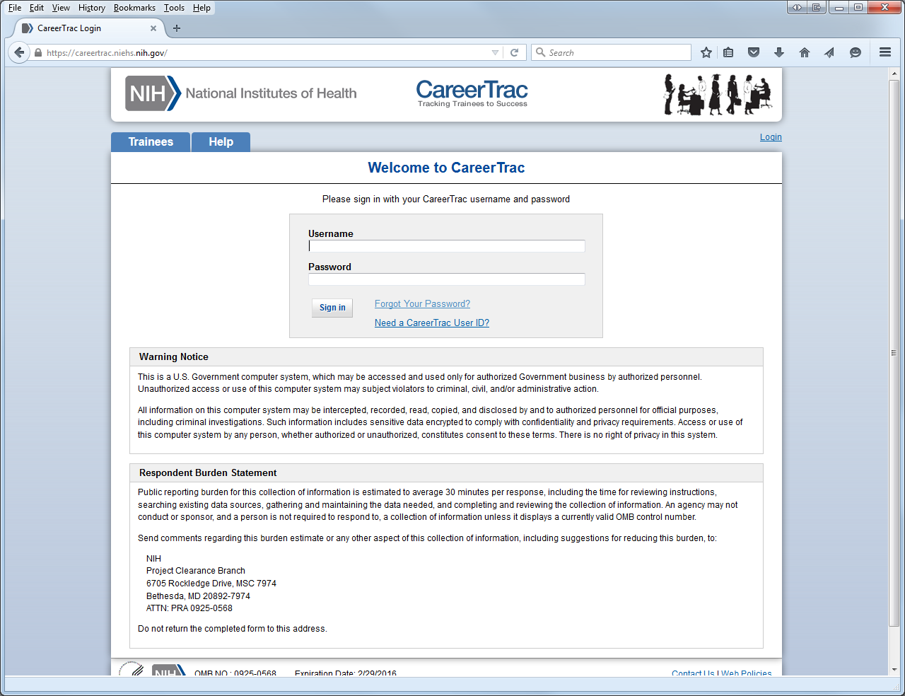
Welcome to CareerTrac
If you forgot your password, click on this link, and type in your username. You will receive a new password in your email (that you have on file with us).
If you are a Center Administrator or a designated POC for an R01/R25 PI and would like access to CareerTrac, please have your Center Director or PI send me an email requesting that you be added (danielle.carlin@nih.gov).

Slide 3
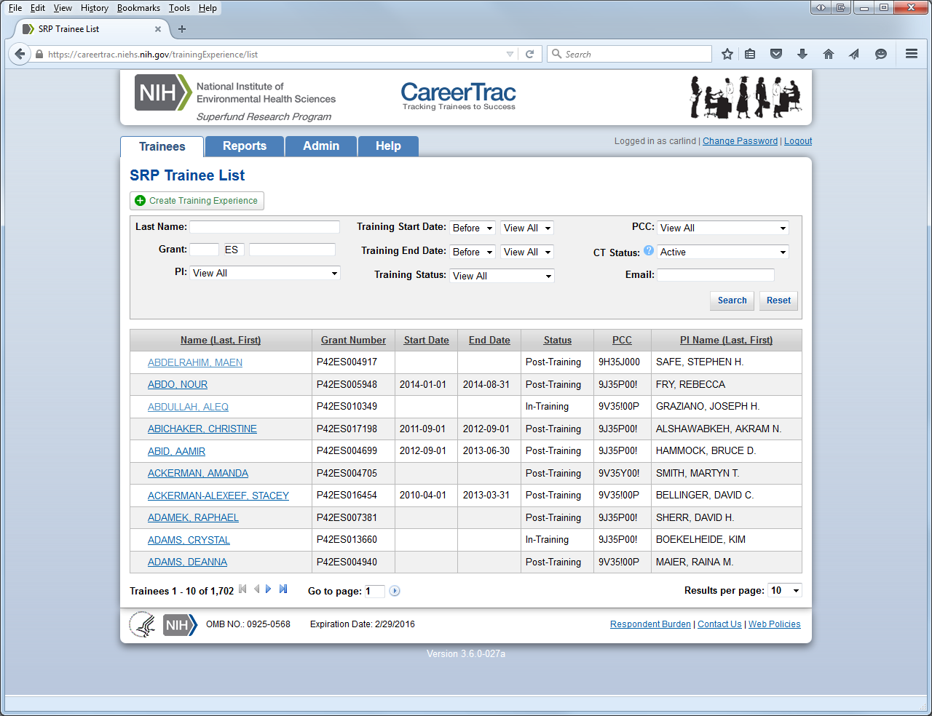
Next page: Trainee List
You will not have access to this tab.
You will only see your Center’s/grant’s trainees

Slide 4
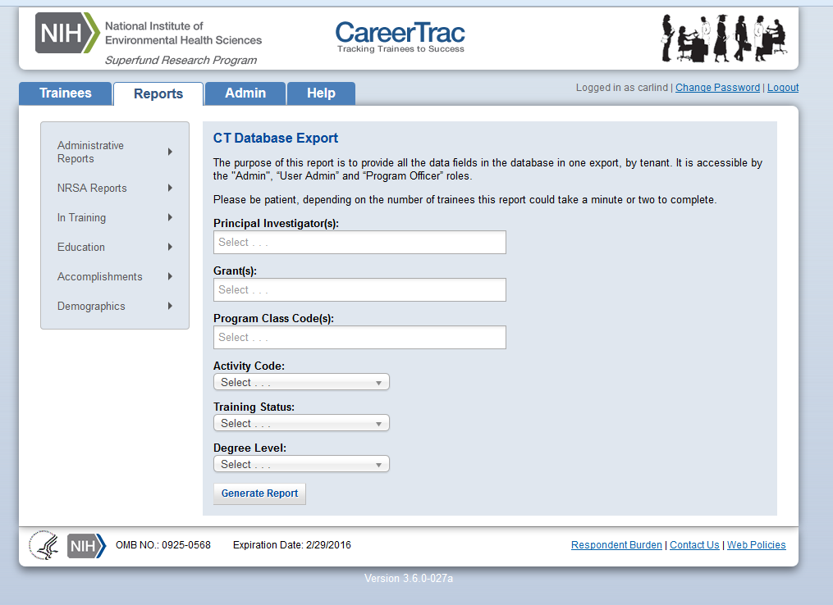
Reports of interest to you!
These reports can help in renewal applications!

Slide 5
HELP!!!!

Slide 6
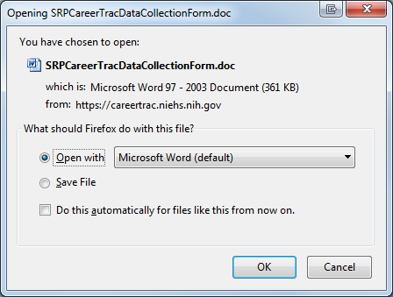
Help: CareerTrac Trainee Form
Email this form to your trainees; they fill it out, send back to you, and you will have to enter the information into CareerTrac

Slide 7
Help: Reports and Queries Manual

Slide 8
Help: Navigating and Data Input

Slide 9
Help: eRA Commons User Guide

Slide 10
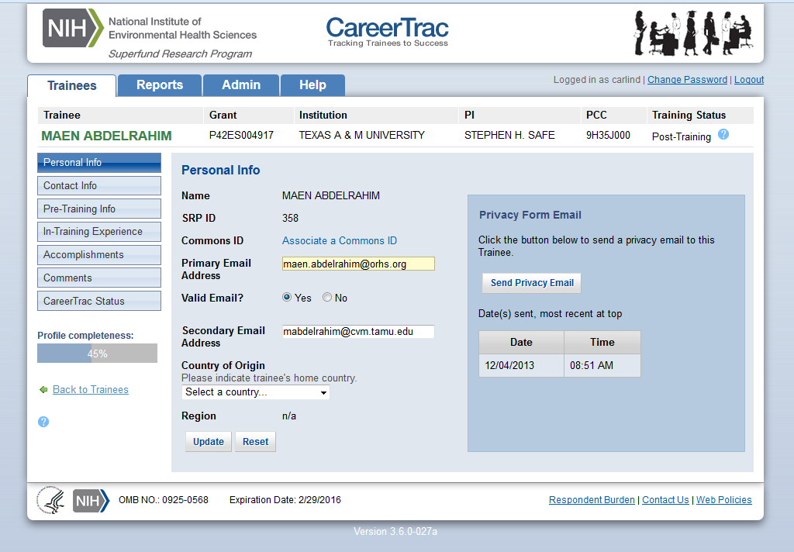
Adding Trainee Info
All of the previous guidance/help will assist you in completing your trainees’ CareerTrac fields

Slide 11
Future Considerations/Directions
Trainee information will have to continue to be added manually by Center Administrators or POCs for R01/R25 PIs
All trainees need eRA commons IDs
SRP will be checking for completeness on trainee information and will be following up with specific Centers/R01s/R25s if trainees information is incomplete
If a trainee becomes an alumni, please add their most current position and email to CareerTrac
If you post a trainee highlight in the SRP Data Collection Tool, please be sure to also add that information to CareerTrac

Slide 12
CareerTrac: https://careertrac.niehs.nih.gov/
SRP Data Collection Form: https://tools.niehs.nih.gov/srp/rtc/index.cfm

Slide 13
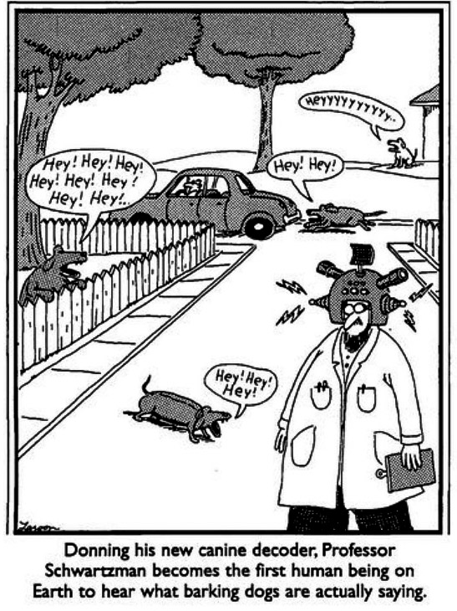
Questions?
THANK YOU!

